Slide 1
PRINCIPLES AND METHODS
OF RADIATION PROTECTION

Slide 2
Basic principles of radiation protection
Notes:
Reduction of radiation exposure is the primary goal for a radiation protection programme. The basic philosophy is defined by the ALARA principal (as low as reasonably achievable).

Slide 3

Basic principles of radiation protection
Justification of practice
Optimization of protection
Individual dose limits
Notes:
The primary aim of radiological protection is to provide appropriate standards of protection for humans from practices involving radiation exposure, without unduly limiting the benefits of these practices. The system of radiological protection for proposed and continuing practices is based on the following general principles:
The justification of a practice. No practice involving exposure to radiation should be adopted unless it produces sufficient benefit to the exposed individual or to society to offset the radiation detriment it causes.
The optimization of protection. All exposures shall be kept as low as reasonably achievable, economic and social factors being taken into account
Individual dose limits. The dose equivalent to individuals shall not exceed the recommended dose limits.

Slide 4
As low as reasonably
achievable
Notes:
ALARA philosophy
The ALARA philosophy is based on the assumption that exposure to radiation poses a risk. The cautious assumption that a proportional relationship exist between dose and effect for all doses (non-threshold concept) is the basis for ALARA. Since, in a statistical sense, any radiation exposure carries a risk, however small, exposures should be kept as low as reasonably achievable - ALARA.
The goal of radiation safety is to keep radiation exposures--both internal and external--As Low As Reasonably Achievable (ALARA).

Slide 5
Primary methods
of radiation protection
Notes:
Reduction of radiation exposure is the primary goal for a radiation protection programme. The basic philosophy is defined by the ALARA principal (as low as reasonably achievable).

Slide 6
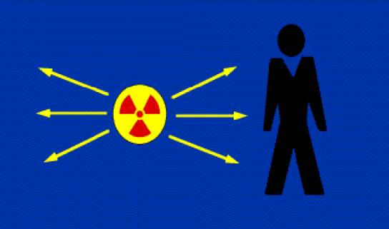
Basic methods of protection against exposure to ionizing radiation
Three basic factors
  time
  distance
  shielding
Notes:
External Exposure
External exposure precautions may be necessary when working with photon emitters or high energy beta emitters such as P-32. Exposure is controlled by three basic factors: time, distance and shielding.

Slide 7
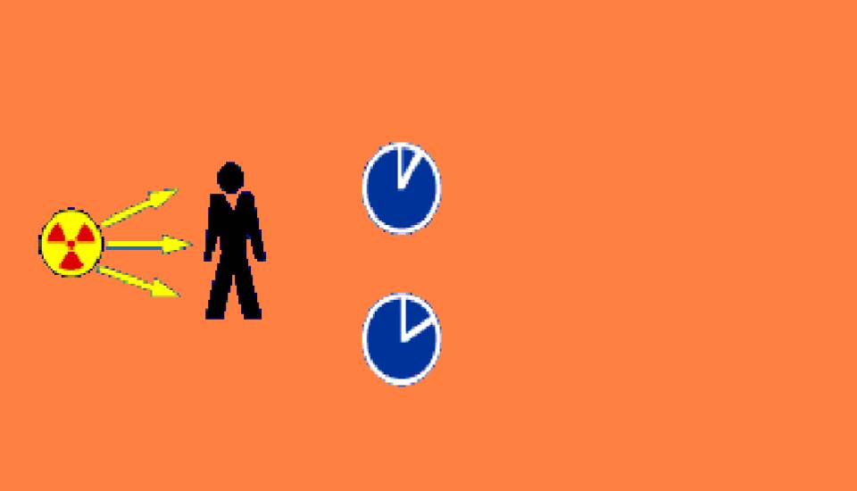
Time
Exposure rate
=10mGy/h
Time = Total dose
X
1 hour = 10 mGy
2 hours = 20 mGy
Notes:
The amount of exposure an individual accumulates is directly proportional to the time of exposure. The longer the time spent exposed to radiation the greater the potential for absorbing a dose of radiation. It is therefore important to minimize the time near radioactive sources. Never sit, chat, read or hold telephone conversations in the presence of radioactive materials.

Slide 8
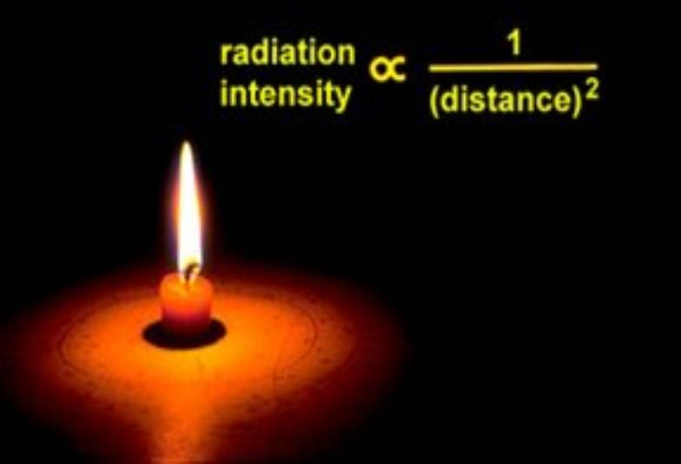
Distance
Notes:
In the same way that heat from a fire is less powerful the further away you are, the intensity of radiation decreases the further you are from the source.

Slide 9
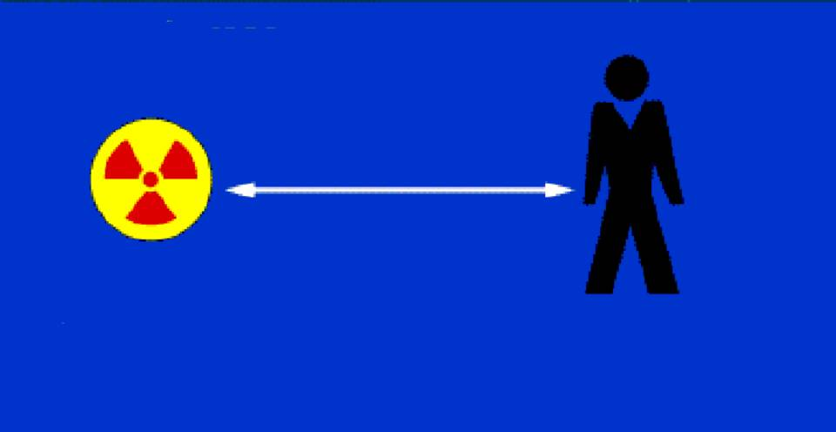
Inverse square law
d=50cm
150 mSv/h
0.06 mSv/h
Notes:
Distance effect
It is very important to recognize how rapidly exposure falls off with distance from the source. The relationship between distance and exposure follows the inverse square law - the intensity of the radiation exposure decreases in proportion to the inverse of the distance squared. For example, in contact with a 37 MBq vial of sodium 22, the exposure rate is about 150 mSv/hr. At only 50 cm from the source, the exposure is reduced to only 0.06 mR/hr. It is therefore advisable to stand as far as away as possible from radioactive sources. Carrying boxes, forceps and remote handling tools should be used for manuplating sources.

Slide 10
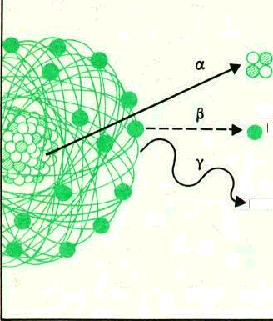
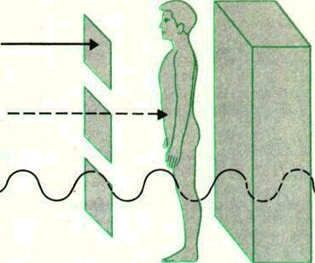
Penetrating power of radiation
Notes:
Exposure hazard
Alpha particles are the least penetrating of the three types of ionizing radiation. They do not penetrate the skin and can be stopped by a piece of thin paper or clothing. A health hazard may occur when alpha-emitting materials are inhaled, swallowed, or enter the body through a wound. Thus, alpha particles are an internal hazard only.
Beta particles can travel several hundred times the distance of alpha particles in air, penetrate skin and tissue, and require a few millimeters of of aluminum to stop them. Thus, beta particles can be both an external and internal hazard.
Gamma rays are the most penetrating type of radiation and can travel many meters in air and many centimeters in tissue. Because gamma rays can travel through the body, they are sometimes referred to simply as “penetrating radiation”. Like beta particles, gamma rays constitute both an internal and external hazard.

Slide 11
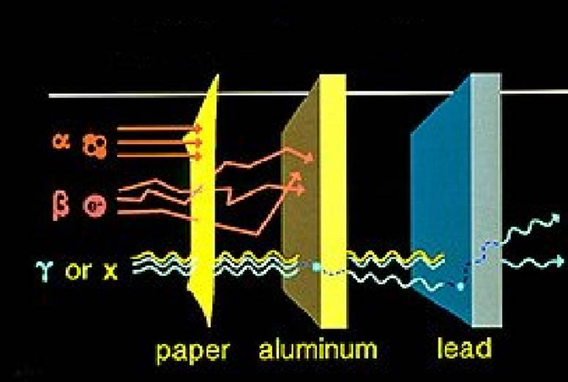
Protection against external exposure
Notes:
Shielding alpha and beta particles
Due to the fact that alpha and beta particles deposit so much energy over such a short distance they are very easy to shield. Alpha particles require little or no shielding as they travel only a very short distance in air.
For beta-emitting radioisotopes, low atomic number material such as plastic is recommended. Plastic will adequately shield the betas and keep bremsstrahlung production to a minimum. The thickness of the shield will depend on the range of the beta in the chosen material. A 3/8" plexiglass shield is recommended when working with P-32.

Slide 12
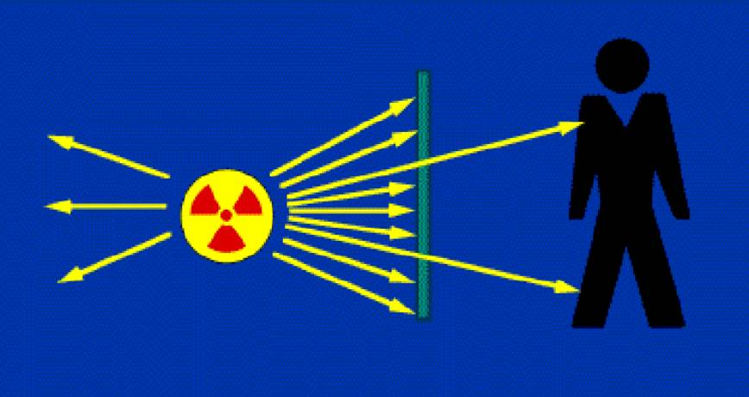
Shielding photons
Notes:
X and gamma rays are diminished in intensity by any absorber but not completely stopped. Materials having a high atomic number can absorb more photons than lighter elements. For X and gamma emitters, shielding is usually lead. The thickness will depend on the half value layer of the photon in the chosen material.

Slide 13
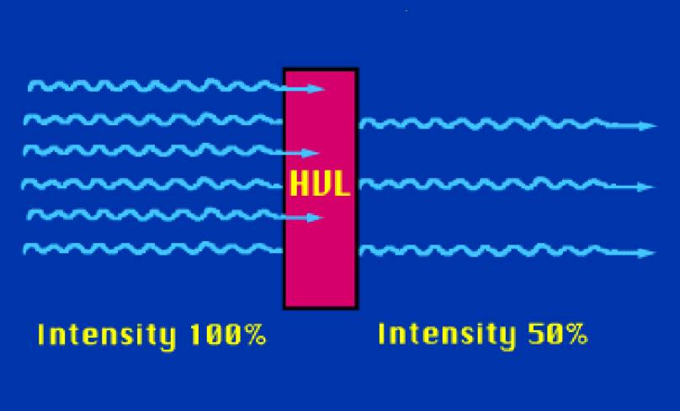
Half value layer (HVL)
Notes:
The ability of shielding material to attenuate radiation is generally given as half value layer. This is the thickness of the material which will reduce the amount of radiation by 50%.
An example of a photon emitters in the lab is Cr-51. For chromium, shielding is usually lead. It takes about 3.5 mm of lead to attenuate one half of the chromium photons.

Slide 14
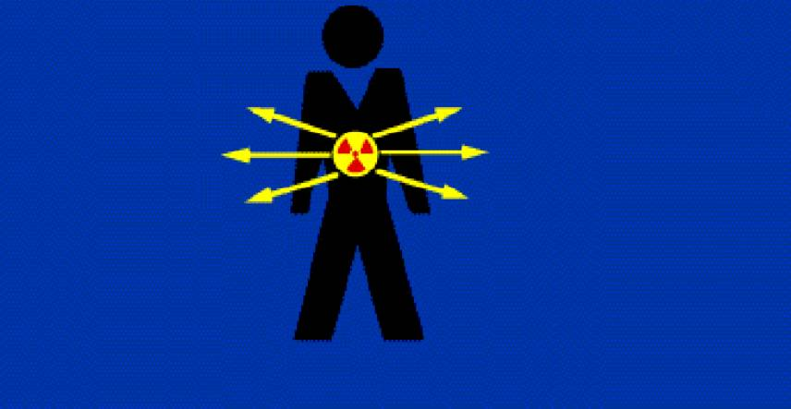
Internal exposure
Notes:
There is a potential for internal exposure if radionuclides are taken into the body. Entry into the body can occur by inhalation, ingestion, or absorption through the skin.

Slide 15
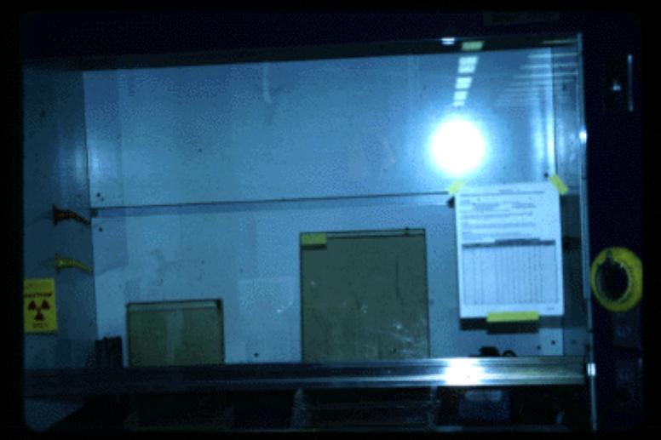
Inhalation
Notes:
Control of inhalation is accomplished by working with volatile compounds in a fume hood. Iodinations are the most common work involving volatile radioactivity. Iodinations may be performed only if approved as a special condition on the laboratory licence and may be performed only in fume hoods that have been approved by the Radiation Safety Office and have effluent air sampling systems installed.
Each worker must register with the Radiation Safety Office before iodinating and receive monthly thyroid bioassays.

Slide 16
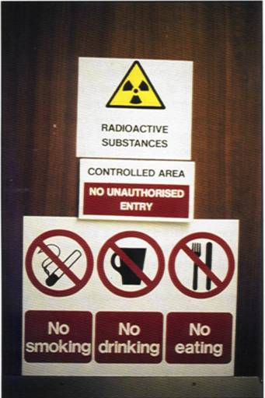
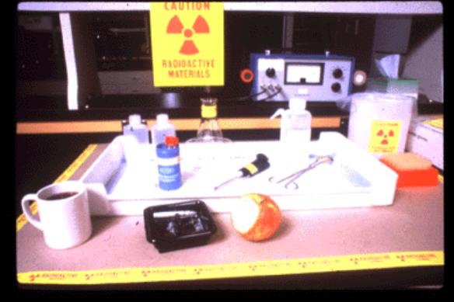
Ingestion / Absorption
Notes:
Control of ingestion and absorption through the skin is accomplished by following safe work habits, identifying radiation use areas, controlling contamination, and laboratory monitoring.
No eating, drinking, smoking, storage of food or mouth pipetting is permitted in areas where radiation is used or stored.

Slide 17
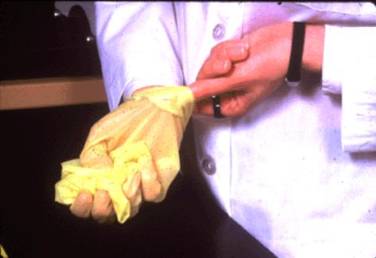
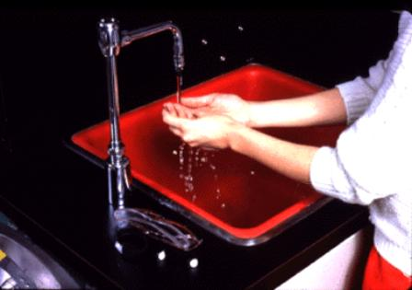
Protective clothing and hand washing
Notes:
Lab coat and gloves must be worn when handling radioactive material or when working in a labelled radiation work area. Safety glasses or other appropriate splash shields should be used when handling radioactive material.
Hands should be washed thoroughly after working with radioactive material.

Slide 18
Principles of modification of radiation injury
Notes:
There are several environmental factors which, in general, modify the degree of damage due to radiation. These physical factors include dose rate and fractionation, radiation quality, and temperature. In addition, several chemicals can modify the radiation effect.

Slide 19
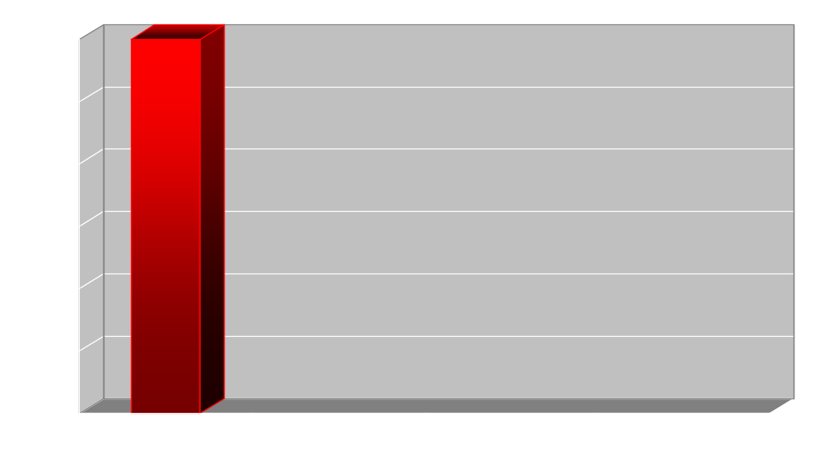
Dose rate
Time
Acute exposure with high dose rate
Prolonged exposure
with lower dose rate
Notes:
In general, the lower the rate of delivery of radiation dose and the more time between radiation exposures, the more resistant the biological system becomes. This is thought to be due to the repair of sublethal lesions before additional lesions, which cumulatively are lethal, can occur. At the cellular level, this may reflect the multitarget theory.

Slide 20
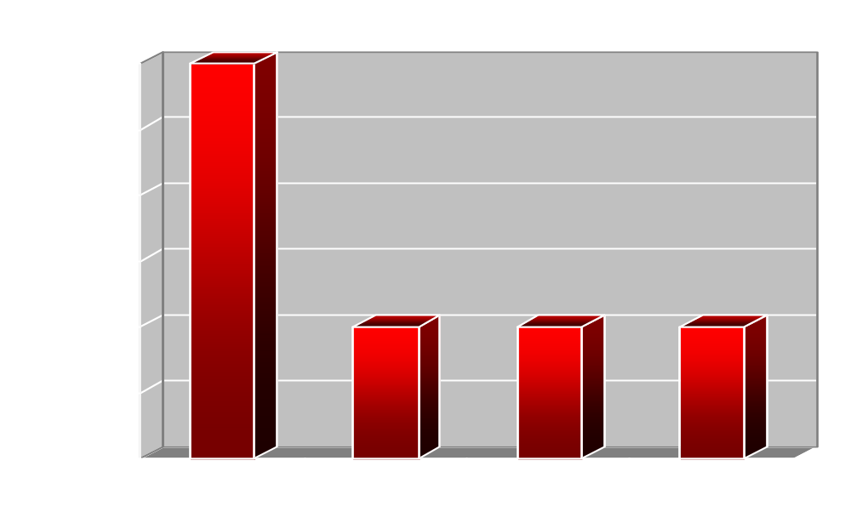
Dose fractionation
Time
Acute
dose
Fractionated dose
Notes:
It is thought that several radiation events in close proximity, probably in the DNA or chromatin structure, must occur in a time frame short enough to cause a lethal outcome. If not in close enough proximity, or if separated by long periods, natural repair can occur and the cell survives.
In DNA, a single broken bond (i.e. single strand break) can be repaired, but a breakage of both strands (i.e. double strand break) is often irreparable. However, repair is possible if the two breaks occur far apart in time, or at different ends of the DNA molecule.

Slide 21
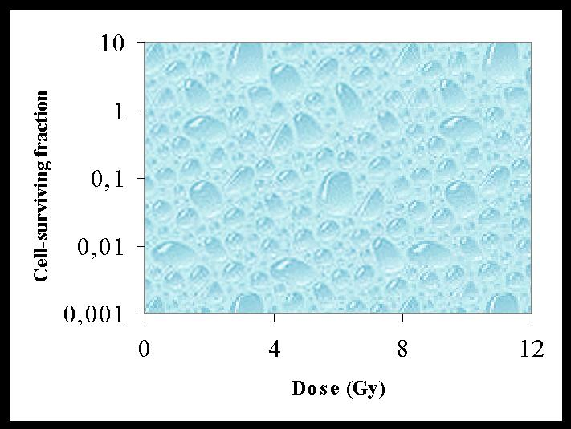
Radiation quality
n
Dq
1-1/e
1-1/e
0,037
D₀
D₀
B
A
Survival curve for mammalian cells exposed to
high- (A) and low- (B) linear energy transfer radiation
Notes:
Densely ionizing or high-LET radiation such as alpha particles, neutrons and heavy charged particles is more effective in the induction of chromosome aberations and killing than sparsely ionizing or low-LET radiation, such as X and gamma rays. The increase in the relative biological effectiveness (RBE) for cell killing with increasing LET is largely attributable to the reduction in repair. Survival curves for both high- and low-LET radiation appear to be exponential. The slopes of the curves are steeper in the case of high-LET radiation. The cell survival curves with lines exposed to low LET radiation show a shoulder that is attributed to the capability for repair.

Slide 22
Temperature
For cell kiling effects, tissues are more radiosensitive at higher temperatures
Chromosome aberrations increase at lower temperatures (suppression of repair process)
Notes:
While many cells at higher temperatures are sensitized to radiation damage, several chromosome aberrations increase at lower temperatures. This is probably due to the suppression of the repair process at low temparatures. For cell killing effects, tissues of higher temperatures are more radiosensitive.

Slide 23
Oxygen
Dissolved oxygen in tissues increases stability and toxicity of free radicals
Oxygen enhancement ratio (OER) is determined by:
The OER has a maximum value of 3.0
Dose required to cause effect without oxygen
OER =
Dose required to cause effect with oxygen
Notes:
Several natural or added chemical agents, if present in the cells and tissues before exposure, can modify sensitivity to radiation.
Oxygen As discussed earlier, dissolved oxygen in the tissues increases the stability and toxicity of free radicals. The degree by which the effect is increased as a result of oxygenation, is called the oxygen enhancement ratio (OER), and is determined by:
Dose required to cause effect without oxygen
OER= ----------------------------------------------------------
Dose required to cause effect with oxygen
The OER has a maximum value of 3.0.

Slide 24
Radiosensitizing agents
Halogenated and substituted analogs of DNA bases:
5-bromo-uracil and 6-thio-guanine
Electroaffinic compounds:
nitroimidazoles (misonidazole, nitroimidazole, and nitrofuran)
sensitization enhancement ratio (SER)
of 1.2 to 1.4
Notes:
Several chemicals can increase the damaging effects of radiation. Analogues of purines and pyrimidines have this effect. Halogenated and substituted analogues of the DNA bases can interfere with DNA repair after radiation damage. Examples include 5-bromo-uracil and 6-thio-guanine.
Actinomycin D inhibits nuclear RNA synthesis and potentiates radiation damage.
Nitroimidazoles (misonidazole, desmethymisonidazole, 5-nitroimidazole, and nitrofuran) are electronaffinic compounds that increase radiosensitivity of cells with a sensitization enhancement ratio (SER) of 1.2 to 1.4, where
Dose required to cause effect without agent present
SER= --------------------------------------------------------
Dose required to cause effect with agent present

Slide 25
Radioprotective agents
Thiols (cysteine, 2-mercaptoethylamine, cystamine) have dose reduction factor (DRF) ratio of 1.4 to 2.0
They are thought to protect cells by
  scavenging free radicals;
  producing hypoxia;
  temporarily inhibiting DNA synthesis, allowing time for the repair enzymes to complete repair of sublethal damage;
  forming disulphide bonds in proteins, thereby strengthening them
Notes:
Chemicals able to diminish the effect of radiation are called radioprotective agents. The dose reduction factor (DRF) measures this protection and is derived by
Dose to cause effect with protector present
DRF= ---------------------------------------------------------------------
Dose to cause effect without protector present
Thiols are sulphur containing reducing agents such as cysteine, 2-mercapto-ethylamine, cystamine and thiourea. Thiols have a DRF ratio of 1.4 to 2.0. They are thought to protect cells by scavenging free radicals, producing hypoxia and forming disulphide bonds in proteins, thereby strengthening them. They also temporarily inhibit DNA synthesis, allowing time for the repair enzymes to complete repair of sublethal damage.

Slide 26
Principles and methods of prophylaxis of external contamination

Slide 27
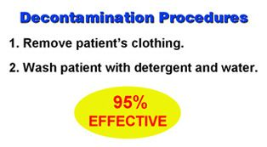
Decontamınatıon
Notes:
Skin decontamination should be undertaken to decrease the risk of skin beta burns, to lower the risk of internal contamination of the patient, and to reduce the potential of contaminating caretakers and the environment.
After the patient's clothing is removed, showering or washing the patient with detergent and lukewarm water is 95 per cent effective. Soap and detergents emulsify and dissolve contamination. Gentle brushing or the use of an abrasive soap or abrasive granules may be indicated. They physically dislodge some contamination held by skin protein, or remove a portion of the horny layer of the skin. Addition of a chelating agent helps by binding the contaminant in a complex as it is freed from the skin.
Keep in mind that the stratum corneum of the epithelium is replaced every 12-15 days. Thus, contamination that is not removed and is not absorbed by the body will be sloughed within one-two weeks.

Slide 28
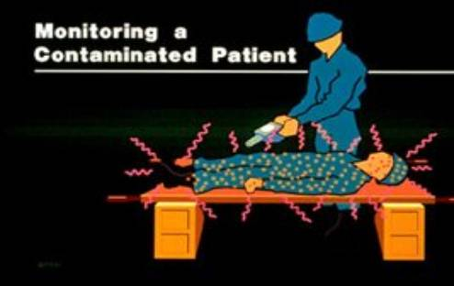
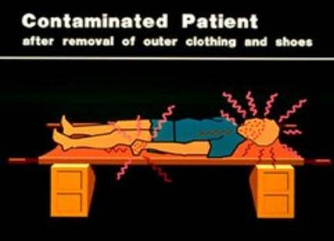
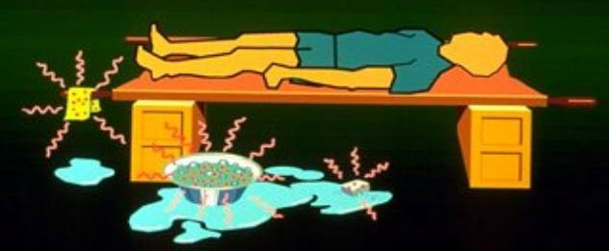
Decontamination techniques
Notes:
Many cases of skin decontamination will be performed by non-medical personnel at or near the accident scene. When initial cleansing methods are not effective, the patient should be referred to a physician. The physician's decision on decontamination procedures should be based on an understanding of the physical and biological principles involved. Success in achieving the objectives stated above requires thoughtful appraisal of the level of residual contamination, rate of decontamination, and condition of the skin - factors that change as the cleansing procedures proceed.
The area of skin contaminated must be clearly determined using appropriate monitoring techniques. After monitoring, this should be covered to prevent spread of contamination. Contaminated skin on the head or near any body orifice is decontaminated followed by other areas. In the latter case, areas of highest contamination have first priority. Swipes or swabs of contaminated areas should be taken for analysis to determine amounts and identity of radionuclides, and decontamination effectiveness. Strict contamination control procedures should be used in handling these skin swipes/swabs.

Slide 29
Solution for skin decontamination
Common soap or detergent solution
for skin and hair; low acidity (pH ~5) recommended
Chelating agents:
  solution of EDTA 10% for skin or hair contamination with transuranium, rare earth and transition metals
  DTPA 1% in aqueous acid solution (pH ~4) for washing skin after contamination with transuranics, lanthanides or metals (cobalt, iron, zinc, manganese)
Potassium permanganate
5% aqueous solution should be used carefully
Hydroxylamine or sodium hyposulfite
5% freshly prepared aqueous solutions
Reducing agents apply after KMn0₄ or Lugol,
then wash with water
Notes:
Soaps and detergents can emulsify and dissolve contamination and are frequently all that are needed for decontamination of skin. Abrasive soap or abrasive granules (i.e. cornmeal) dislodge some contamination physically held by skin protein or remove a portion of the horny layer. In any case, tepid water (never hot) should be used for decontamination.
Chelating agents, sodium hypochlorite, and titanium dioxide (an abrasive) have been successfully used in previous contamination accidents. The abrasive agents must not be used on the face. While additional chemical techniques are seldom necessary, they can be used but only with care and expert advice.
Potassium permanganate, an oxidizing agent, and subsequent application of sodium acid sulphite to neutralize the permanganate, will remove a portion of the horny layer. In cases where contamination is localized in thick, horny areas more aggressive methods can be used but again with expert advice. Fine sandpaper can be used to remove localized contamination.
Dermabrasion should be used with great care and only after expert consultation. Sticky tapes have limited usefulness since they tend to remove the horny layer rapidly and can increase percutaneous absorption.

Slide 30

Therapeutic agents for skin decontamination
Antiphlogistic topical ointment:
  To be applied for fixed contamination, especially useful for contamination of fingers
Isotonic saline solution for eyes
Isotonic 1.4% bicarbonate solution for removing uranium from body
Lugol solutions for iodine contamination
Acetic acid solution (pH 4 to 5) or simply vinegar for decontamination of ³²P
Notes:
Antiphlogistic topical ointment:
To be applied for fixed contamination; must be kept 24-48 hours under an occlusive dressing; creates an osmotic gradient which pumps the radionuclide from the skin towards the outside; especially useful for finger contamination.
Isotonic saline solution for eyes.
Isotonic 1.4% bicarbonate solution for removing uranium contamination.
Lugol solutions (50 mg iodine and 100 mg potassium iodide per millilitre) for decontamination of radioactive iodine compounds from the skin. It has to be followed by application of sodium hyposulphite and then rinsed with water.
Acetic acid solution (pH 4 to 5) or simply vinegar for contamination by ³²P; wash and then rinse with water.

Slide 31
Principles and methods of prophylaxis of internal contamination

Slide 32
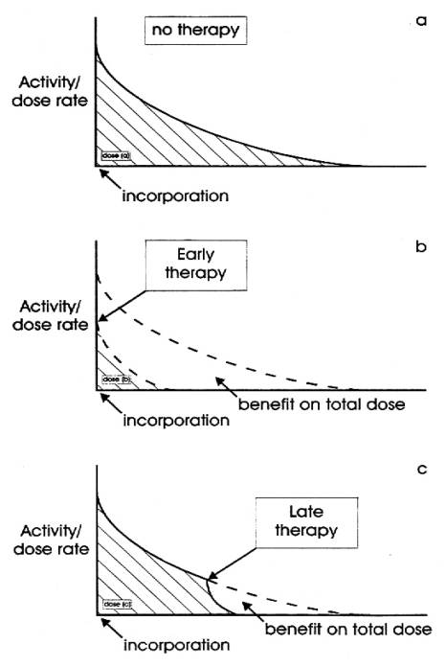
Treatment of internal contamination
Treatment procedures:
the sooner started – the more effective
In practice, initial treatment decisions based on accident history rather than careful dose estimates
Notes:
Early recognition of internal contamination provides the greatest opportunity to remove the contaminant and reduces the potential for harm.
Committed dose is the time integral of the dose rate, which decreases as radioactivity diminishes. If the therapeutic action is performed promptly, the benefit in reducing the dose may be significant. In practice, the critical initial treatment decisions have to be based on the accident history, rather than dose estimates. Additional treatment should then be based on more detailed estimates of the maximum credible accident, information from air and surface sampling, and early reports of in-vivo measurements and bioassay.
The basic premise for treatment of persons with internal contamination is to reduce the absorbed radiation dose and hence the risk of possible future biological effects. The means available must be used to reduce absorption and internal deposition; and enhance excretion of absorbed contaminants. Both are most effective when begun at the earliest possible time after exposure.

Slide 33
Basic principles of treatment of internal contamination
Reduce absorption and internal deposition
Enhance excretion of absorbed contaminants
Notes:
Respiratory contamination Little can be done to reduce lung absorption and deposition. Expectorants and mucolytics have not proven effective in increasing the transit rate of insoluble particles to the posterior pharynx. The deposition of insoluble particles may cause fibrosis and pulmonary scarring with resultant pulmonary restrictive disease.
Lung lavage has been used in several patients. This is accomplished under general anaesthesia, with a double-cuffed, double-lumen endotracheal tube. One cuff is inflated within the trachea and the other cuff is inflated in one main stem bronchus to isolate the two lungs. One lung is filled with irrigating fluid and allowed to drain by gravity drainage. This is repeated two to three times for each lung. The greatest risk in this procedure is the general anaesthesia, not the fluid-filled lung. Lung lavage is used infrequently and the risk/benefit should be considered carefully.
Gastrointestinal contamination The gastrointestinal system is more accessible and amenable for decontamination. Stomach lavage, if done early after ingestion of the contaminant, may be effective. Irrigating solution and gastric contents should be retained and sent for dosimetry analysis. Emetics can be used in conscious patients soon after ingestion. Syrup of Ipecac, followed by large amount of drinking water may induce vomiting. Apomorphine subcutaneously may also be used as an emetic. Magnesium sulphate forms insoluble sulphates with some radioactive materials, reducing absorption. Adsorbents like activated charcoal are used with some success to reduce chromium absorption. Aluminium containing antacids bind with strontium, decreasing the uptake of strontium. Alginates, made from brown sea algae (kelp) and used commonly as a bulking agent in ice cream products, decrease the uptake of strontium as well. The antacid Gaviscon contains 200 milligrams of alginate per tablet. Ten grams of alginate decreases the absorption of strontium by a factor of 10.

Slide 34
Methods of treatment of internal contamination
- Saturation of target organ, e.g. potassium iodide for iodine isotopes
- Complex formation at site of entry or in body fluids followed by rapid excretion, e.g. DTPA for Pu isotopes
- Acceleration of metabolic cycle of radionuclide by isotope dilution, e.g. water for ³H
- Precipitation of radionuclide in intestinal lumen followed by faecal excretion e.g. barium sulphate administration for ⁹⁰Sr
- Ion exchange in gastrointestinal tract, e.g. prussian blue for ¹³⁷Cs
Notes:
The physician may encounter any number of radioactive contaminants following accidental release. Historically, however, only a relatively small number of radionuclides have commonly been encountered in potentially serious accidents. These include ³H, ⁶⁰Co, ⁹⁰Sr, ¹³⁷Cs, ¹³¹I, ²²⁶Ra, ²³⁵U, ²³⁸U, ²³⁸Pu, ²³⁹Pu, and ²⁴¹Am. Treatment for internal contamination requires a knowledge of the potential risk involved. Treatment is closely linked with metabolic information. The urgency and importance of the treatment depends on the efficiency of the therapeutic method and the amount of the contaminant.
Current methods to remove radioactive contaminants involve:
- saturation of the target organ e.g. potassium iodide for iodine isotopes
- complex formation at the site of entry or in body fluids followed by rapid excretion, e.g. DTPA for Pu isotopes
- acceleration of the metabolic cycle of the radionuclide by isotope dilution, e.g. water for ³H
- precipitation of the radionuclide in the intestinal lumen followed by faecal excretion e.g. barium sulphate administration for ⁹⁰Sr
- ion exchange in the gastrointestinal tract, e.g. Prussian blue for ¹³⁷Cs.
For practical reasons, it is convenient to consider soluble and non-soluble materials separately. Indeed the metabolic behaviour and therapeutic actions are mainly governed by this duality.

Slide 35
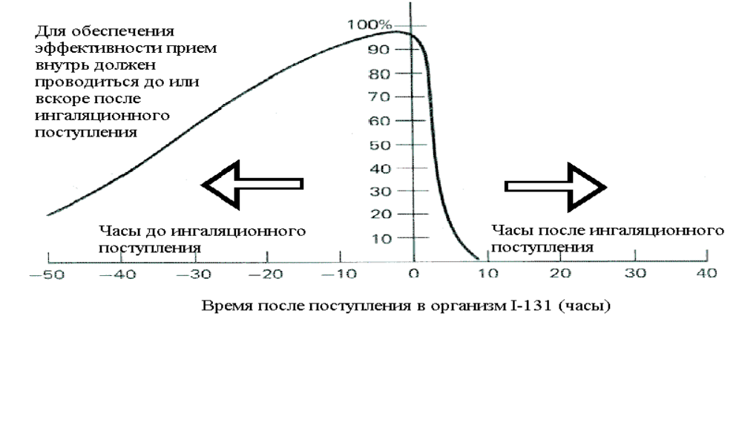
Application of preparations of stable iodine
Time before inhalation
Time after inhalation
Time after incorporation of iodine-131, hours
Application of KI in tablets allows to prevent the harmful effects of internal radiation caused inhalation or per os reception of iodine-131
Notes:
For maintenance of high efficiency reception of preparations of stable iodine should be carried out up to or right after incorporation of radioactive iodine

Slide 36
Diluting agents: water for tritium - ³H
Single exposures are treated by forced fluid intake:
Enhanced fluid intake e.g. water, tea, beer, milk has dual value of diluting tritium and increasing excretion (accelerated metabolism)
Biological half-life of tritium - 10 days
Forcing fluids to tolerance (3-4 L/day) reduces biological half-life to 1/3-1/2 of normal value
Notes:
Diluting agents
Tritium follows the pathway of water in the body, penetrates skin, lungs, and GIT, either as tritiated water (HTO) or in the gaseous form. Tritium contamination can be treated by forced fluid intake. Enhanced fluid intake e.g. water, tea, beer, milk has the dual value of diluting the tritium and increasing excretion (accelerated metabolism). This treatment reduces the biological half-life of tritium by a factor of two.

Slide 37
Ion exchange: prussian blue for ¹³⁷Cs
¹³⁷Cs - physical half-life T_{p}=30 years; biological half-life in adults average T_{b}=110 days, in children 1/3 of this
Prussian blue effective means to reduce body's uptake of caesium, thallium and rubidium from the gastrointestinal tract
Dosage of prussian blue: one gram orally 3 x daily for 3 weeks reduces T_{b} to about 1/3 normal value
Notes:
Prussian blue
Caesium-137 is easily absorbed by the body through ingestion, inhalation, and skin penetration. Its physical half-life is 30 years, and its biological half-life is 110 days. It emits beta and penetrating gamma radiation, and it is distributed uniformly throughout the body.
Prussian blue is ferric ferrocyanide. This chemical is not absorbed by the gastrointestinal tract (GIT) and works through two modes of action. It decreases the absorption of many radionuclides from the GIT and removes some radionuclides from the capillary bed surrounding the intestine and prevents their reabsorption. Prussian blue is most effective when given early after ingestion and serially, for 2-3 weeks, thereafter.
In Goiania (Brazil, 1987) following the release and human incorporation of caesium-137 from a medical radiation source, prussian blue was used to treat contaminated human victims. Prussian blue decreases the biological half-life of caesium-137 to 30 per cent.

Slide 38
Chelation agents: DTPA for heavy metals and transuranic elements
Ca-DTPA is 10 times more effective than Zn-DTPA for initial chelation of transuranics. Must be given as soon as possible after accident
After 24 hours, Ca-DTPA and Zn-DTPA equally effective
Repeated dosing of Ca-DTPA can deplete body of zinc and manganese
Dosage of Ca-DTPA and Zn-DTPA:
1 g iv. or inhalation in a nebulizer
Initially: 1 g Ca-DTPA, repeat 1 g Zn-DTPA daily up to five days if bioassay results indicate need for additional chelation
Pregnancy: First dose Zn-DTPA instead of Ca-DTPA
Notes:
Chelation agents
Chelators are mobilizing agents; they enhance the elimination of metals from critical organs. Chelators are organic compounds (ligands) that exchange less firmly bonded ions for metal ions. The stable complex, chelator and metal, is then excreted by the kidney. Hence, chelators are effective means for decorporation of radioactive heavy metals.
Diethylenetriaminepentaacetic acid (DTPA), is generally more effective in removing many of the heavy metal, multivalent radionuclides. The chelates formed with many heavy metals are water soluble and excreted via the kidneys. The DTPA metal complexes are more stable and less likely to release the radionuclide before excretion. After intravenous administration, the agent is excreted rapidly with about 50% appearing in the first hour. Treating promptly with the highest recommended dose of the chelate produces the greatest enhancement of the radionuclide excretion. The effectiveness of treatment at later times following a radionuclide uptake is directly related to the solubility of the metal in vivo and its presence in the extracellular spaces.
Actinides (plutonium, americium, curium, and californium), all have long biological half-lives. Inhalation is approximately 75% of industrial exposures. If the compound is soluble (nitrate, citrate, fluoride), it is ultimately translocated from the lungs to terminal disposition sites (bone and liver). Ca-DTPA and Zn-DTPA chelation therapy is the treatment of choice.
As with most chelators, it is more effective the earlier it is given. Both salts can be given intravenously or as a nasal inhalant. Dose recommendations are, for adults, 1 gram in 100 to 250 mL of normal saline infused intravenously slowly, over 3 to 4 minutes, and repeated on 5 successive days per week. Given as aerosol, 1 gram in a 4 mL vial is placed in a nebulizer, and the entire volume is inhaled over 3 to 4 minutes, repeated daily.
With repeated dosing, Ca-DTPA can deplete the body of zinc and, to a lesser extent, manganese. Zinc-DTPA replacement therapy is recommended when repeated dosing is done due to loss of the body's zinc stores.
Contraindications for Ca-DTPA: pregnancy, infancy, nephrosis and bone marrow depression. Teratogenicity and fetal death have occurred in mice.
No serious toxicity in humans has been reported when used in recommended doses. When given repeatedly with short intervals for recovery, nausea, vomiting, diarrhoea, chills, fever, pruritus, and muscle cramps have been noted.

Slide 39
Additional chelating agents
Dimercaprol (BAL) forms stable chelates, and may therefore be used for the treatment of internal contamination with mercury, lead, arsenic, gold, bismuth, chromium and nickel
Deferoxamine (DFOA) effective for chelation of 59Fe
Penicillamine (PCA) chelates with copper, iron, mercury, lead, gold. Superior to BAL and Ca-EDTA for removal of copper (Wilson’s disease)
Notes:
Chelation therapy has been used for lead, mercury, arsenic, and other heavy metals.
Chelators are most effective prior to the binding of a toxicant in the critical organ but can be used with variable results after target organ acquisition.
Before, during and after chelation therapy, pertinent measurements of radioactivity in the body should be made to determine the efficacy of treatment. By the fifth day, evaluate the bioassay data of urine and faeces samples and the total-body and chest count measurements. Continuation of therapy is determined by assessing chelation yield with remaining body burden.

Slide 40
Summary of lecture
Goal of radiation safety: keep radiation exposure as low as reasonably achievable
Dose rate and fractionation, radiation quality, temperature, oxygen and several chemicals can modify the radiation effect
Attend to life-threatening injuries first
Earlier skin decontamination decreases degree of beta burns, lowers risk of internal contamination, reduces chance of further contamination
Goal of internal contamination treatment: decrease uptake into circulatory system, decrease deposition in critical organs, increase excretory rate contaminant
Notes:
Goal of radiation safety: keep radiation exposure as low as reasonably achievable (ALARA)
Dose rate and fractionation, radiation quality, temperature, oxygen and several chemicals can modify the radiation effect
Attend to life-threatening injuries first
Earlier skin decontamination decreases degree of beta burns, lowers risk of internal contamination, reduces chance of further contamination
Goal of internal contamination treatment: decrease uptake into circulatory system, decrease deposition in critical organs, increase excretory rate contaminant

Slide 41
THANKS FOR ATTENTION

